Slide 1
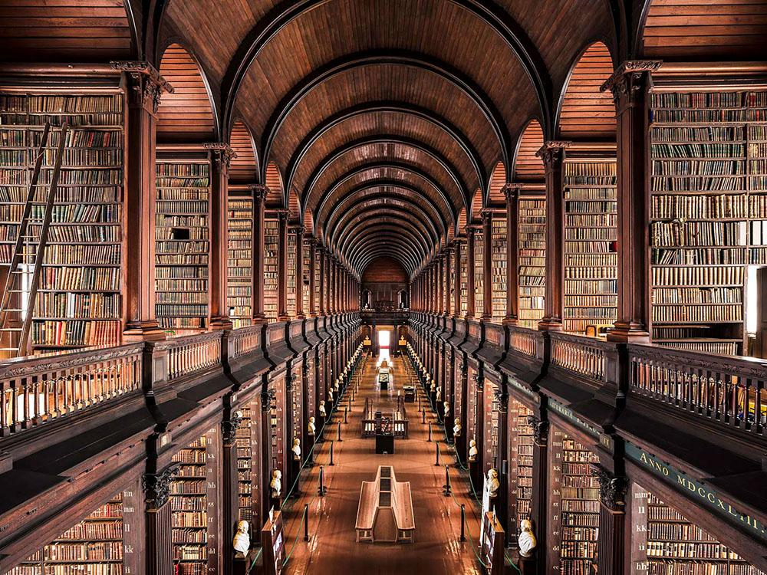
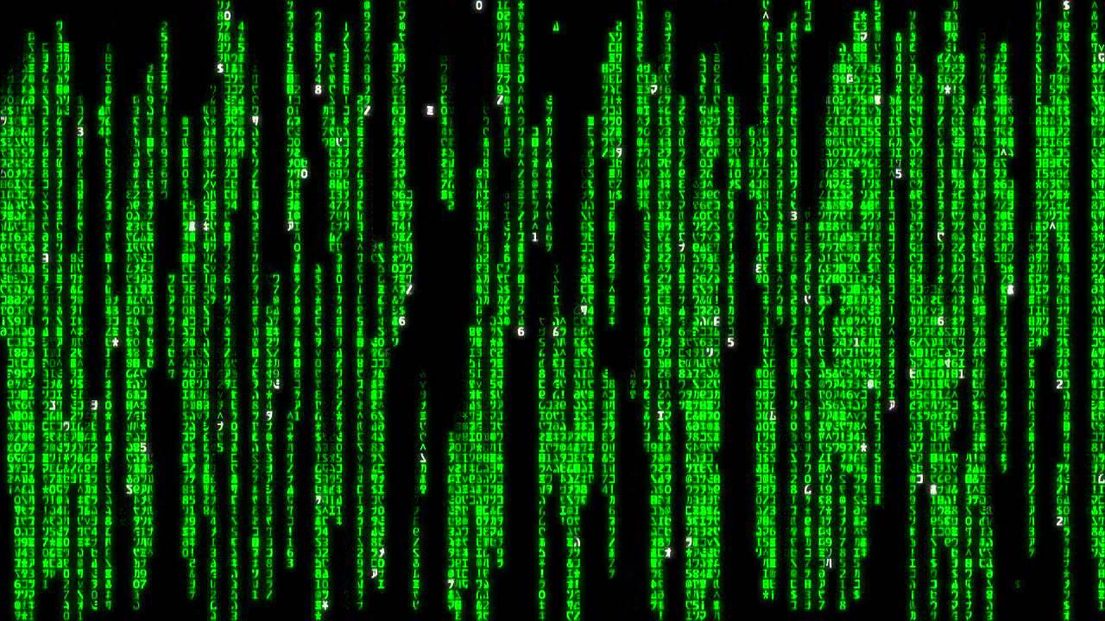
Coding a Library
By Dylan Sain

Slide 2
Where to Start?
Dictionaries
Classes/Objects
Great for categorizing data based on things other than their position in an array.
Works like a dictionary: you look up a word to find its definition.
Used to look up books based on the ID number:
The ID is the ‘word’
The book information will be the definition
Great for simplifying code and grouping together methods and data.
This makes the code easier to understand, use and extend should the need arise.
Used to center all the data in simple packages:
Books, teachers/students and even the library had its own class.
Each one had its own methods that would help the main program

Slide 3
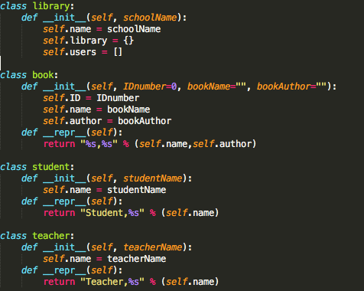
Started with the basics:
Declaring classes
Making sure they worked
Adding functions:
addUser
assBook
After these functions worked I added more.
Eventually the basic functions got more and more complicated as I added more variables and methods.

Slide 4
Adding Owners to Books
Main idea of a library
Added instance of a owner, Student, Teacher or None
Added an array of books in Student and Teacher

Slide 5
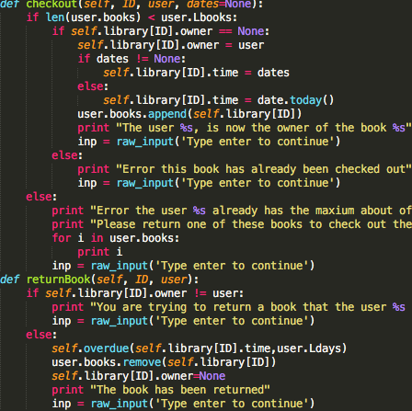

Checkout/Return Process
Checking certain conditions to continue
Removing/Adding a owner to the book
Removing/Adding a book to the array for the owner

Slide 6
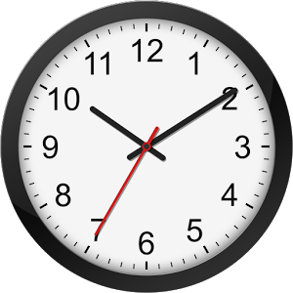
Time/Datetime
Ideas:
End day function?
User inputs?
Importing time?
Time wasn't easy to code, but was the most efficient.

Slide 7
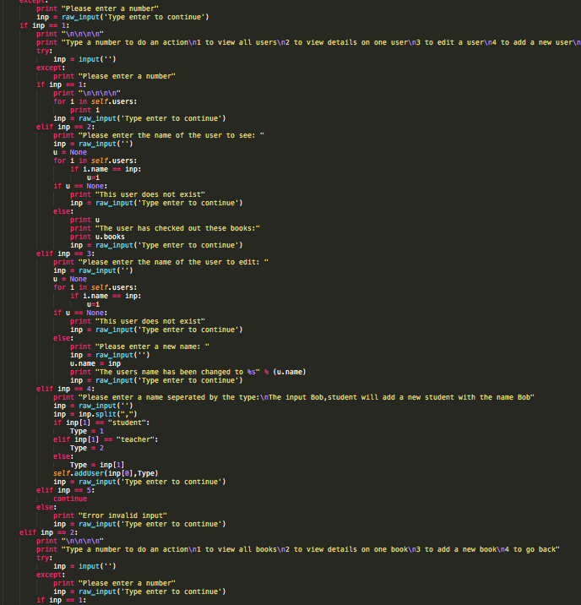
User Interface/Dummy Proofing
Simple:
Ask user question, use input in program
Not as simple as it looks:
Need to make sure that the input is the
correct type/way code wants it
Using try/except and if/else statements

Slide 8
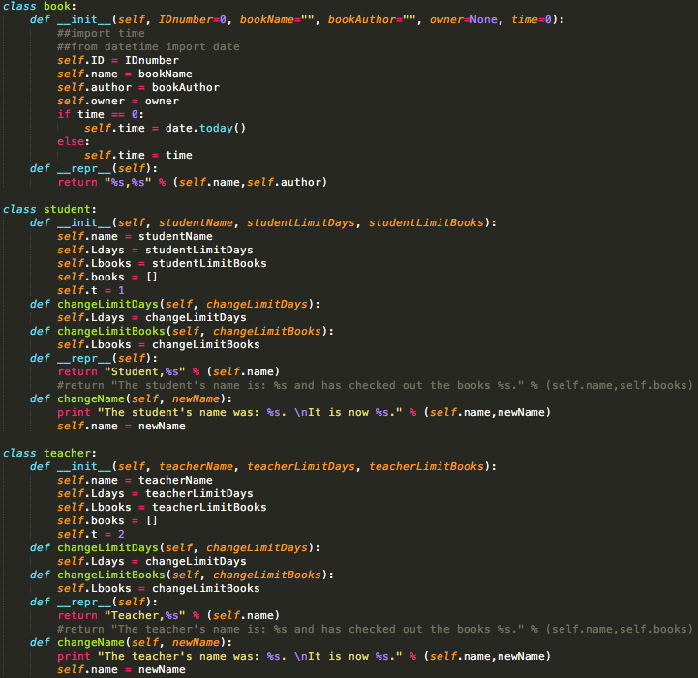
Final product is a lot more complicated than the beginning!

